Slide 1
Intruder detection
Made by Jordan DAHBI & Willy UNG

Slide 2
ProjeCt
Detect intrusions from the main entrance of your home, the detection event is triggered by the opening of the main door. It would be better if the identity of the intruder would be revealed by a camera taking multiple pictures.

Slide 3
Components used
2 micro chipset Arduino Wemos with Wi-Fi connection, (setup: ESP8266)
Many connectors
A OV2640 camera
A simple button or an IR detector

Slide 4
Problems encountered
OV2640 Camera: Very complex to associate with the current controllers

Slide 5

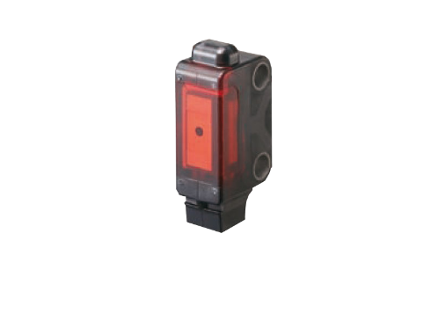


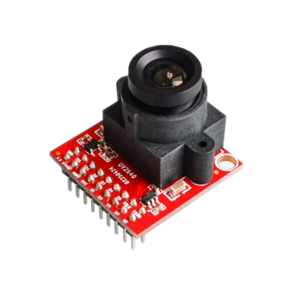
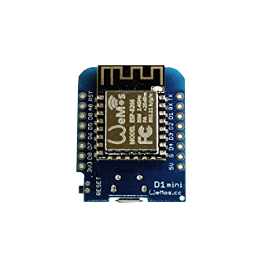

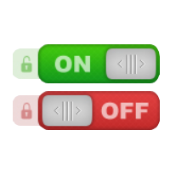
Conception

Slide 6
Result
Detect the opening of the door by a component (button/detector) that will be sent by Wi-Fi to another micro chipset that will trigger an action.
To begin with, the chipset that receive the detection information should have taken pictures but its complexity, technical and time limitations.
Consequently, it has been made with the e-mail sending only.

